Slide 1
Personalized Smart Alarm
BBM467 Data Intensive Applications
Data Science Capstone Project
Ahmet Karaca
Oğuzhan Ertekin

Slide 2
Problem

Slide 3
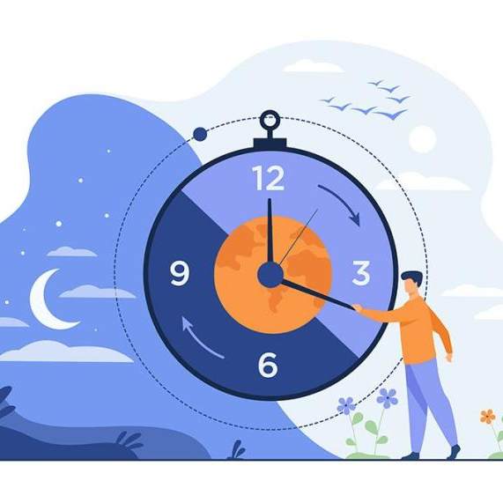
Sleep consists of two basic parts: rapid eye movements (REM) and non-rapid eye movements (NON-REM). These two parts follow each other all night long. Depending on the dream content, all muscles in the body are paralyzed during the REM period of eye movements. If the individual wakes up before the consciousness settles during that time, he/she feels as if he/she will not be able to get up. The most important feature of this stage is that the brain functions are as high as in wakefulness. Everything learned during the day is taken from the cache and archived and filed just like the operating system on the computer. NON-REM sleep consists of light sleep and deep sleep. Sleeps awakened before any cycle is completed are generally considered unproductive sleep.

Slide 4

Although we wake up at the exact time we want with the alarms we use today, we do not always wake up efficiently. For this, we planned to make a special alarm application for a user after knowing about the sleep cycles by tracking the sleep for a certain period of time. However, with the measurements we made with the smart wristbands we have, we realized that sleep is very variable and that there is no pattern for these cycles. Therefore, at this stage, we turned our project into a project in the form of scoring the quality of a sleep entered. According to our research, we considered the sleep quality as GOOD if the sleep quality score is between 80-100, and the sleep quality is MEDIUM if it is between 50-79, otherwise is BAD.

Slide 5
Data Understanding

Slide 6
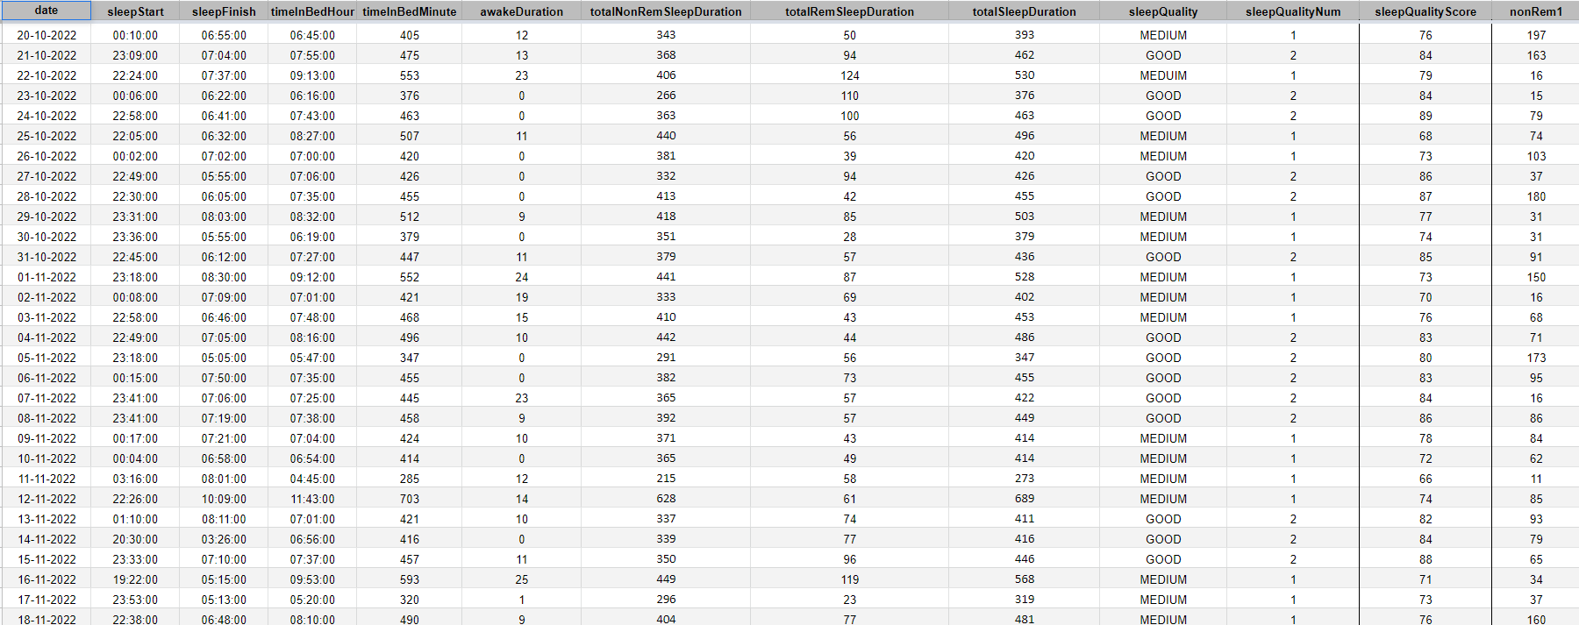
We tracked our sleep through the smart watch we have (MI Band 6). We stored the data we obtained from these measurements in an excel file.
sleepData.xlsx

Slide 7
We created features such as "date, sleepStart, sleepFinish, timeInBedHour, timeInBedMinute, awakeDuration,totalNonRemSleepDuration, totalRemSleepDuration, totalSleepDuration, sleepQualityNum, sleepQualityScore, nonRem1, rem1, ... nonRem10, rem10".
date= Timestamp of sleep
sleepStart= Start time of sleep
sleepFinish= End time of sleep
timeInBedHour= Total time in bed, including awakenings and sleeps
timeInBedMinute= Minute form of timeInBedHour (Hour-> Minute)
awakeDuration= Total awakenings duration
totalNonRemSleepDuration= Total NonRem sleep duration
totalRemSleepDuration= Total Rem sleep duration
totalSleepDuration=Total sleep duration
sleepQualityScore= Quality of sleep in forms of numeric
sleepQuality= If sleepQualityScore is between 80-100 then it is "GOOD",
if sleepQualityScore is between 50-79 then it is "MEDIUM",
otherwise it is "BAD".
sleepQualityNum= If sleepQuality is GOOD then sleepQualityNum is 2,
if sleepQuality is MEDIUM then sleepQualityNum is 1,
otherwise it is 0.
nonRem= NonRem sleep duration in a cycle
rem= Rem sleep duration in a cycle

Slide 8
Data Preparation

Slide 9
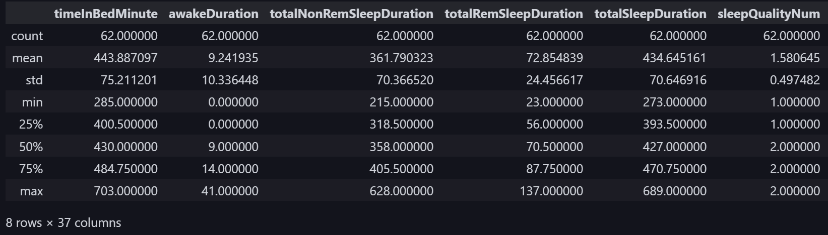
Since we will not be able to use the 'date', 'sleepStart', 'sleepFinish', 'timeInBedHour', 'sleepQuality' features for modeling, we have dropped these values from the dataframe before the modeling phase. We did not use the ".dropna" function as there were no missing values in the data.

Slide 10
Modeling

Slide 11

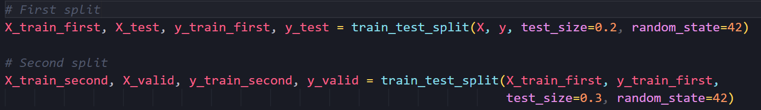
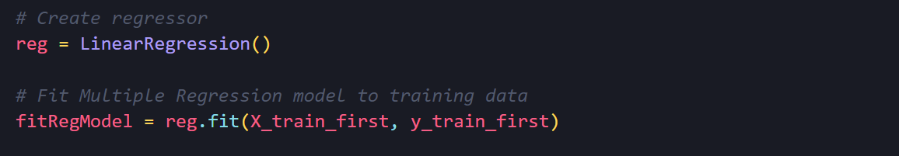
We used Multiple Regression model to estimate sleep quality score using sleep cycles in our data. Multiple regression analysis allows researchers to assess the strength of the relationship between an outcome (the dependent variable) and several predictor variables as well as the importance of each of the predictors to the relationship, often with the effect of other predictors statistically eliminated. We preferred the Multiple Regression model because there were more than one independent factor affecting the sleep quality score in our data.

Slide 12
Evaluation

Slide 13
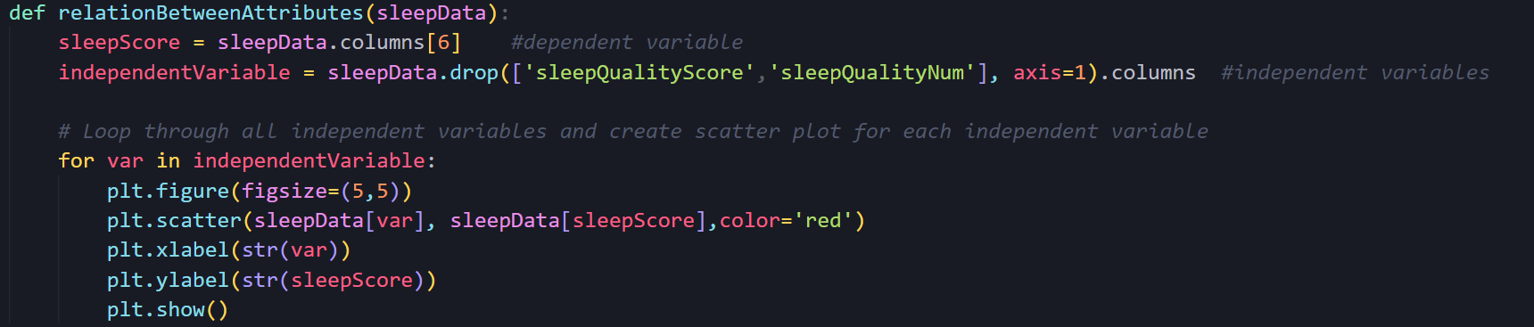
We wrote a function to plot the scatterplots of the relationships between all independent variables (except sleepQualityScore) and the dependent variable (sleepQualityScore)

Slide 14
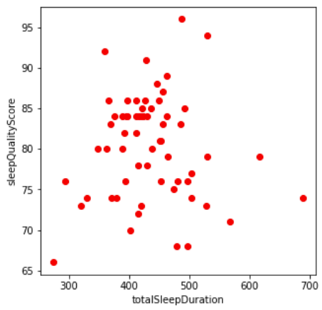
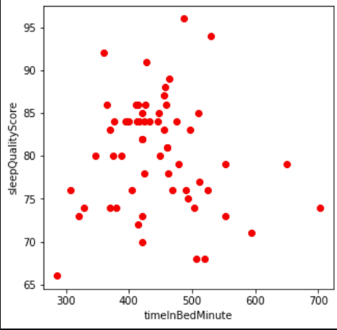
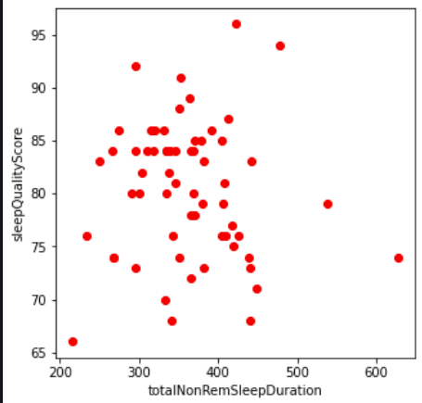
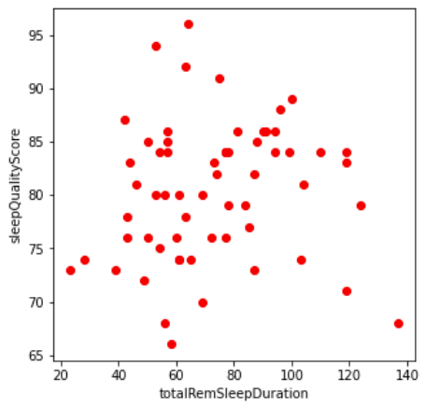
TotalSleepDuration, timeInBed, totalNonRemSleepDuration, and totalRemSleepDuration appear to have the highest positive associations with the total sleep score when considered separately. In general, this makes sense since spending more time in bed should result in more sleep, and as REM sleep has been discovered to be crucial for many restorative processes, including memory formation, more sleep should be obtained.

Slide 15
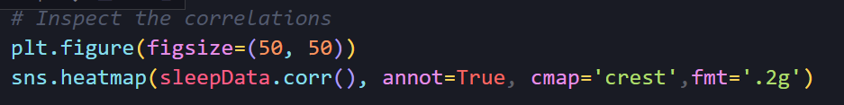
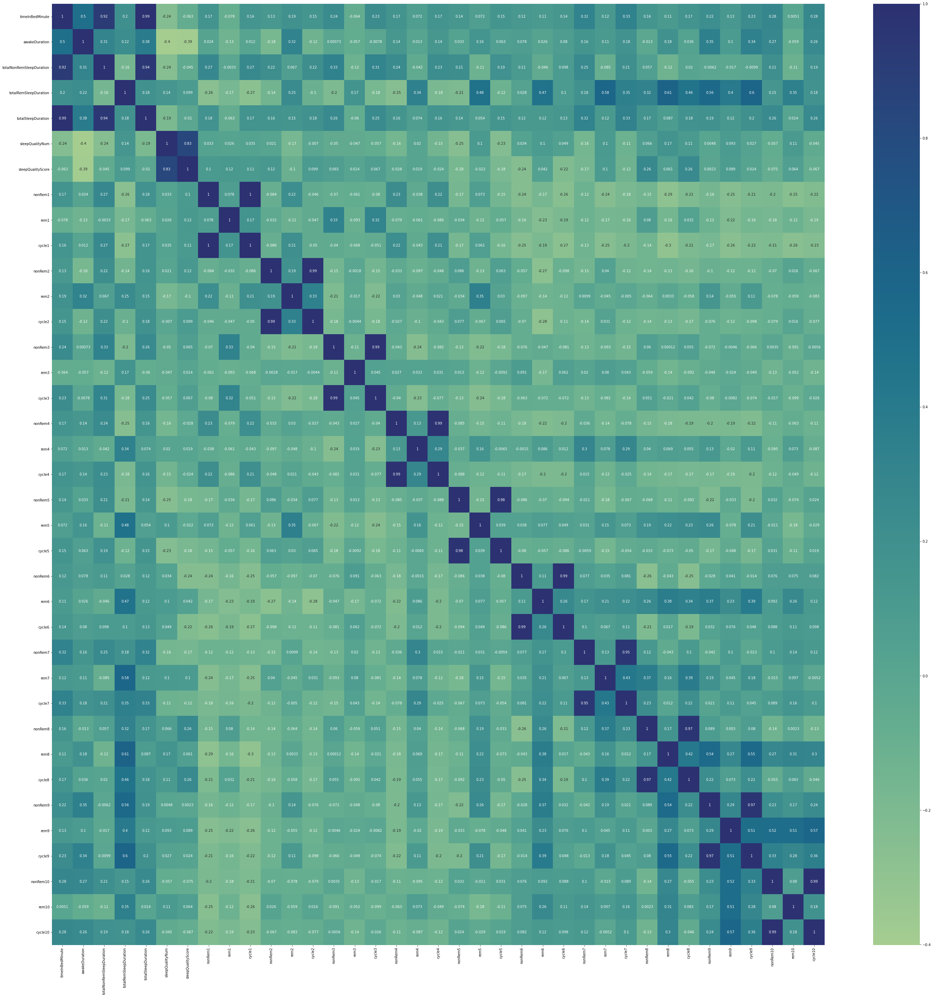

Slide 16
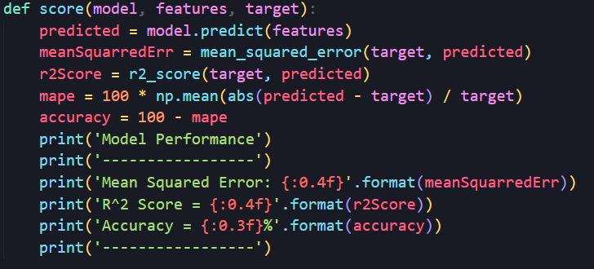
We wrote a function that calculates the r2 score, mean squarred error and accuracy values ​​of the model entered as a parameter

Slide 17
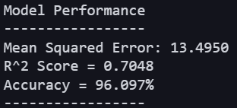
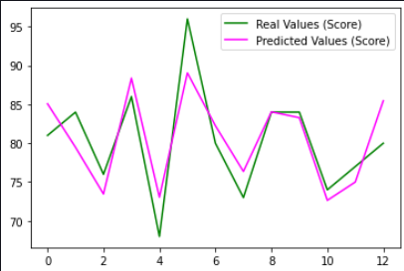
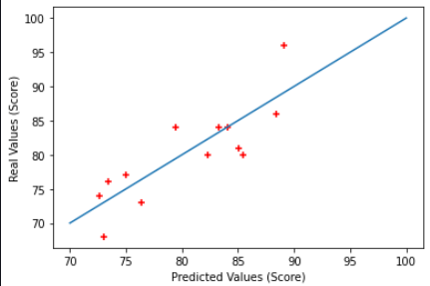
The graphs and model performance of the data obtained after creating the model are as follows.
Looking at the graphs, the real sleep score values ​​and the predicted sleep score values ​​are
observed to be close to each other.

Slide 18
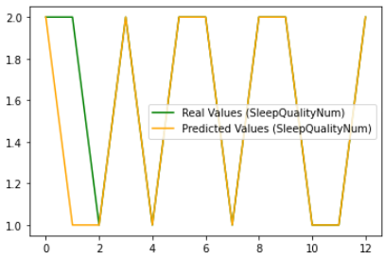
We mentioned sleep quality as MEDIUM when sleepQualityNum is 1, and sleep quality as GOOD when it is 2. In the graph below, it is observed that the real values and the predicted values give close results.

Slide 19
References
1- https://www.sciencedirect.com/topics/economics-econometrics-and-finance/multiple-regression- analysis#:~:text=Multiple%20regression%20analysis%20allows%20researchers,of%20other%20predictors%20statistically%20eliminated
2- https://www.w3schools.com/python/python_ml_multiple_regression.asp
3- https://medium.com/machine-learning-with-python/multiple-linear-regression- implementation-in-python-2de9b303fc0c
4- https://seaborn.pydata.org/generated/seaborn.heatmap.html
5- https://matplotlib.org/stable/tutorials/introductory/pyplot.html
6- Principles and Practice of Sleep Medicine, 4th edition
7- Fundamentals of Sleep Medicine
8- Datacamp Supervised Learning with scikit-learn Course

